Slide 1
E-commerce Capstone Project
CRM Analysis

Slide 2
Introduction
1. Project Overview:
We are analyzing a dataset covering transactions from 01/12/2010 to 09/12/2011 for a unique online retail business in the UK.
The company specializes in offering distinctive all-occasion gifts, catering to both retail and wholesale customers.
2. Objective:
Gain insights into the purchasing behavior and trends of customers during the specified period.
Identify patterns, anomalies, and opportunities within the dataset.
3. Key Features:
Duration: Transactions span from December 1, 2010, to December 9, 2011.
Unique Challenges: Negative quantities represent return transactions, and zero-unit prices may indicate free items.

Slide 3
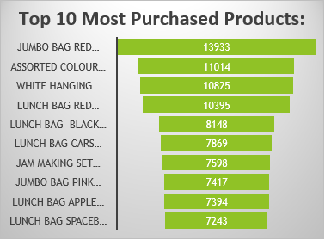
Initial Analysis
UnitPrice :
Mean UnitPrice: $2.1
Standard Deviation: 2.04
Maximum UnitPrice: $8.5
Interpretation:
Majority of products priced around $2.1 with limited variation.
Outliers exist, including a maximum value of $8.5.
Quantity :
Mean Quantity: 4.7 units
Standard Deviation: 4.608
Maximum Quantity: 23 units
Interpretation:
Average purchase involves approximately 4.7 units.
Some transactions show higher quantity, with a maximum of 23 units.
Top 10 Most Purchased Products:
List of the most popular products based on purchase frequency.
Provides insight into customer preferences and product demand.
Top 5 Most Active Customers:
Identifies the customers with the highest transactional activity.
Useful for recognizing and rewarding loyal customers.
Top 5 Most Active Customers:
Unknown | 117677
17841 | 7579
14096 | 4593
14911 | 4325
12748 | 4220

Slide 4
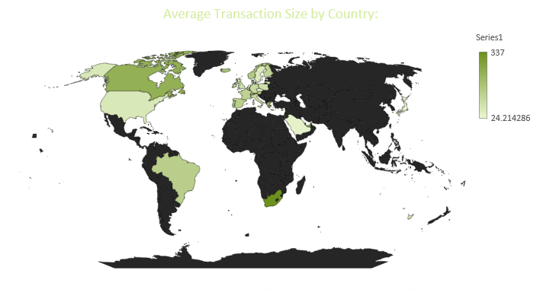
Country-wise Analysis
Top 5 Count of Customers by transaction size in each Country:
RSA | 337
Singapore | 329.5
Lebanon | 314
United Arab Emirates | 246
Canada | 240.5
Business Inferences:
Customer Engagement:
Prioritize strategies for countries with both high transaction sizes and customer counts.
Market-Specific Tactics:
Customize marketing campaigns based on unique characteristics of each country.
Top 5 Count of Customers in each Country:
United Kingdom | 418291
Germany | 7198
France | 6473
EIRE | 5802
Spain | 1942

Slide 5
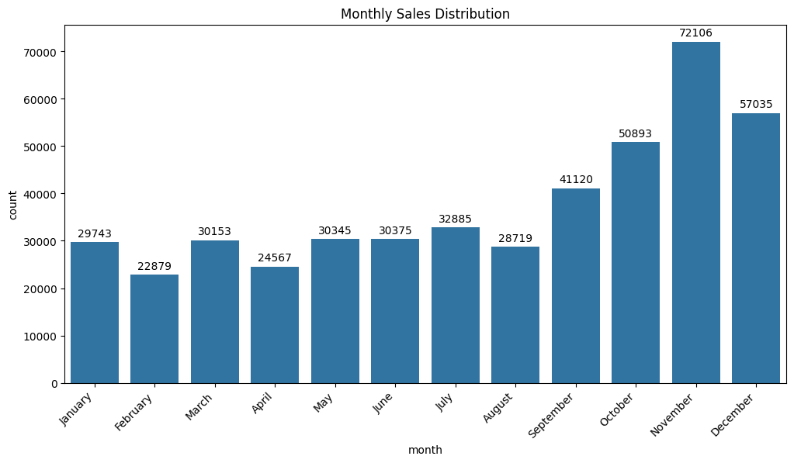
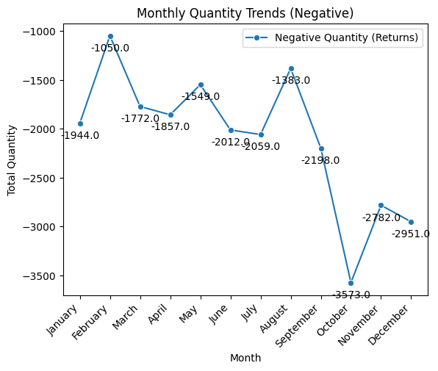
Monthly Analysis
Sales Distribution Monthly:
Top 3 Months:
November: 72,106
December: 57,035
October: 50,893
Last 3 Months:
February: 22,879
April: 24,567
August: 28,719
Analysis by Month - Free Items:
Top Months:
December: 16% of transactions involve free items
May: 12% of transactions involve free items
Last Months:
August: 5% of transactions involve free items
September: 5% of transactions involve free items
Return Graph Insight:
October has the highest quantity of return products.
February shows the lowest quantity of return products.
Analysis by Description for Return Products, Top 3:
Free Item | 372
Jam Making Set With Jars | 87
Set Of 3 Cake Tins Pantry Design | 72

Slide 6
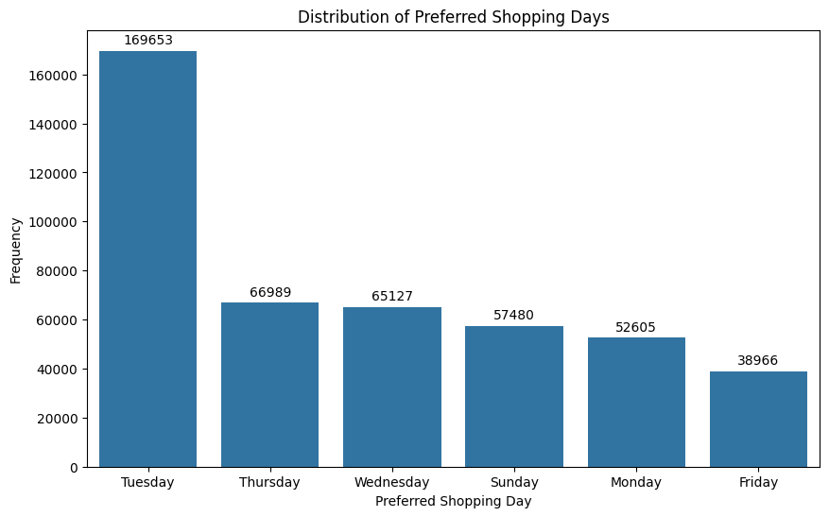
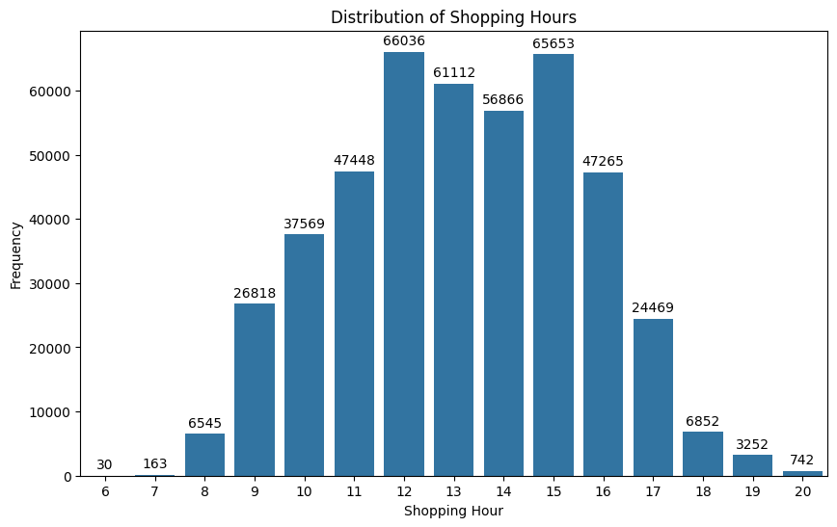
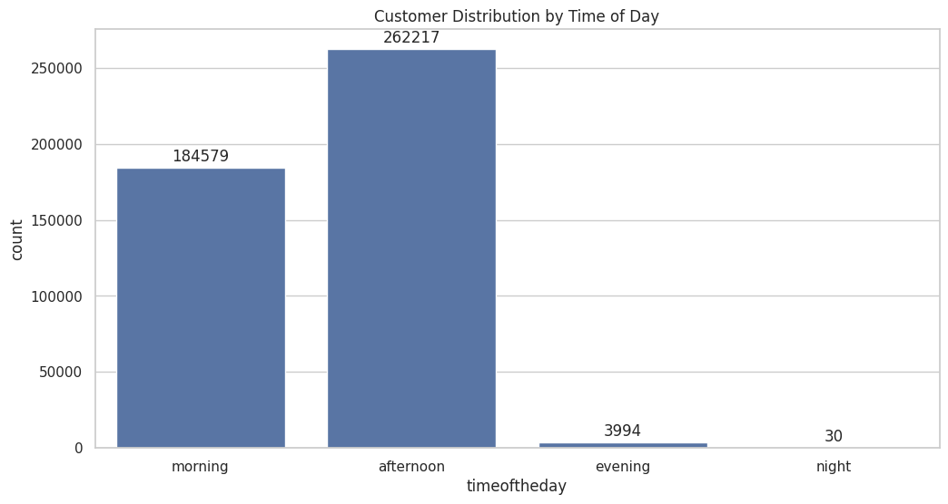
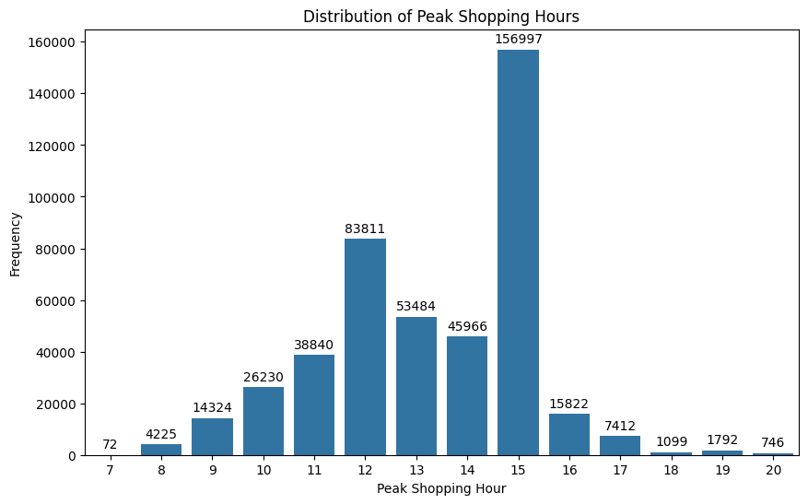
Weekly and Hourly Analysis
Distribution of Preferred Shopping Days:
Highest:
Tuesday: 169,653
Thursday: 66,989
Lowest:
Friday: 38,966
Distribution of Shopping Hours:
Highest:
12 pm: 66,036
3 pm: 65,653
Lowest:
8 am: 6,545
Distribution of Shopping Hours:
Highest:
12 pm: 66,036
3 pm: 65,653
Lowest:
8 am: 6,545
Distribution of Peak Shopping Hours Preferred by Customers:
Highest:
3 pm: 156,997
12 pm: 83,811
Lowest:
8 pm: 742

Slide 7
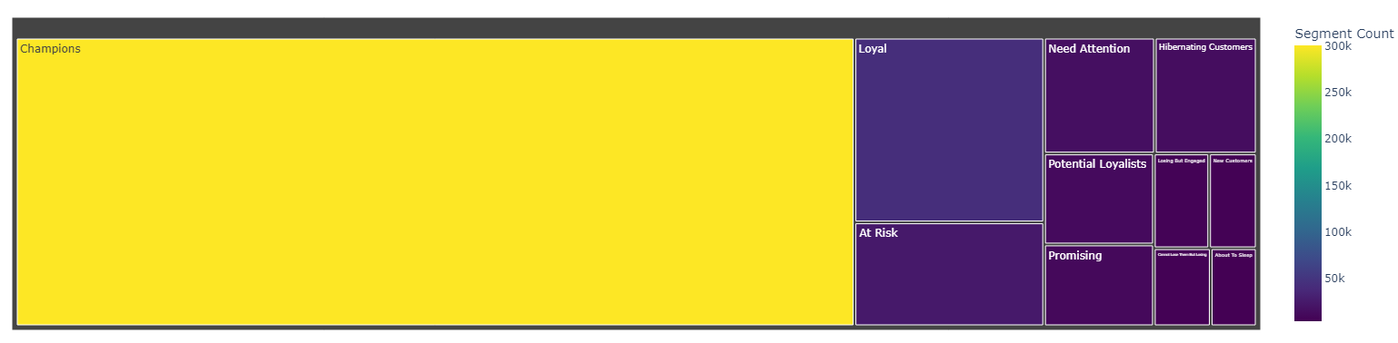
Customer Segmentation using RFM
Segmentation Strategy:
Grouping customers into distinct segments based on their RFM scores.
Segments help identify different customer behaviors and preferences.
Segment Examples:
Champions (555):
Customers with high scores in all categories, indicating loyalty and valuable contributions.
At Risk (255):
Customers with diminishing activity, signaling a need for targeted engagement.
Benefits of RFM Analysis:
Precision Targeting:
Tailor marketing strategies to specific customer segments for higher engagement.
Churn Prediction:
Identify customers at risk of churning and implement retention tactics.

Slide 8
Top Performing and least Performing Customers
Top-Performing Segments:
Champions (300,101):
Strategy: Enhance Loyalty
Offer exclusive rewards, personalized experiences, and early access to promotions.
Encourage repeat purchases with tailored incentives.
Loyal (43,436):
Strategy: Strengthen Engagement
Introduce tiered loyalty programs with special perks and discounts.
Encourage referrals and incentivize them to become brand advocates.
Opportunity for Improvement:
About To Sleep (4,442):
Strategy: Reactivation & Offers
Address declining activity through personalized communications.
Launch reactivation campaigns with exclusive offers.
Losing But Engaged (6,497):
Strategy: Retention & Experience
Address concerns through proactive communication.
Implement retention strategies and enhance overall satisfaction.
Top 5 Segments: | Average Spending by Customer Segment:
Cannot Lose Them But Losing | 15.3
At Risk | 13.76
Loyal | 12.48
About To Sleep | 11.31
Promising | 11.21
Top 5 Segments: | Count:
Champions | 300101
Loyal | 43436
At Risk | 24413
Need Attention | 15908
Hibernating Customers | 14624
Target Champions Segment:
Focus on retaining and engaging with the "Champions" segment (555).
Offer loyalty programs, exclusive deals, and personalized promotions to encourage continued high-value spending.
Re-engage At-Risk and Loyal Customers:
Implement targeted campaigns for customers in the "At Risk" segment (255).
Offer special discounts, personalized communications, and incentives to rekindle their interest.
Personalized Marketing:
Leverage the insights from RFM analysis to tailor marketing messages for each segment.
Send personalized recommendations and promotions based on past purchase behavior.

Slide 9
Thank you

